Slide 1
Lecture 1 – Introduction to computational biology and R
Adam Sorbie
Institute for Stroke and Dementia Research
Munich, Germany
Neuroimmunological methods in stroke 14.02.23

Slide 2
Course objectives
Aimed at students in biological/medical sciences (any discipline).
Develop an understanding of the basics of computational biology.
Practical training:
Introduction to R
RNAseq analysis
16S rRNA sequencing analysis

Slide 3
Structure
Pre-course poll
Computational Biology & R
15 min break
NGS/RNAseq
- 15 min break
16S rRNA sequencing

Slide 4
Lecture Outline
1.
Introduction to Computational biology
2.
Introduction to the R programming language – theory and concepts
3.
Introduction to RNAseq
4.
Introduction to 16S rRNA sequencing

Slide 5
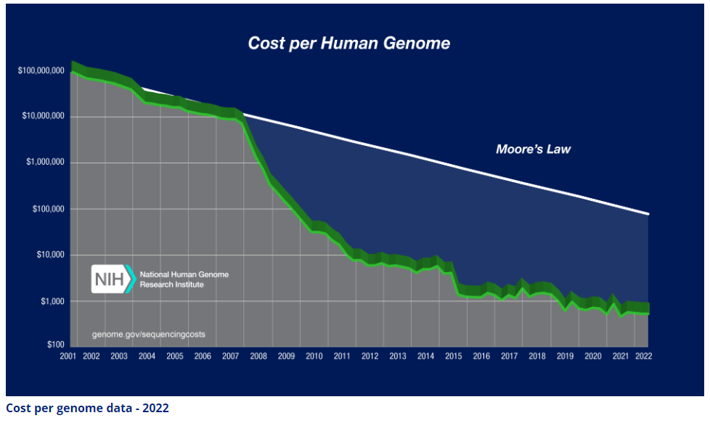
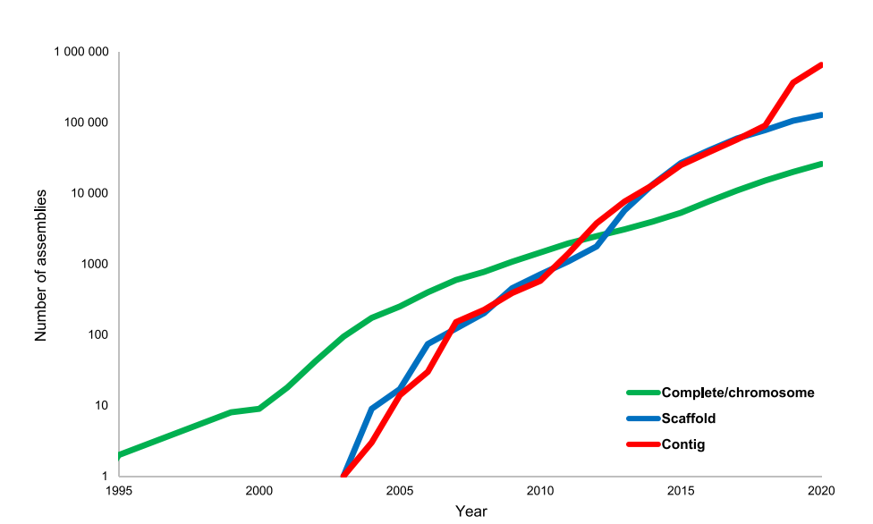
What is computational biology and why is it important?
Computational biology –
Analysis of complex, high-dimensional biological data.
Discovery of new biological insights.
Comp. bio vs bioinformatics
bioinformatics mostly focused on software and algorithm development
Complex omics datasets increasingly common
Rare to see papers without some sort of NGS/mass spec dataset.
Need for people who can understand and extract insights from these datasets.
Source: https://www.genome.gov/about-genomics/fact-sheets/Sequencing-Human-Genome-cost
Koonin, Makarova and Wolf, Trends in Microbiology, 2021
Notes:
Cost of sequencing has decreased dramatically in the last 15 years.
This has led to a massive increase in the volume of data produced by biological experiments.

Slide 6
What skills are required?
Programming/Data wrangling
Required for data processing, analysis and visualisation.
High-performance computing
Some datasets may be too large or use too much resources for a normal laptop/desktop PC.
Statistics
At least some understanding of applied statistics
Domain knowledge
Understanding of the underlying biology
Stats
Biostats
Data
science
Bioinformatics
Biology
Comp. sci
Comp. biology

Slide 7
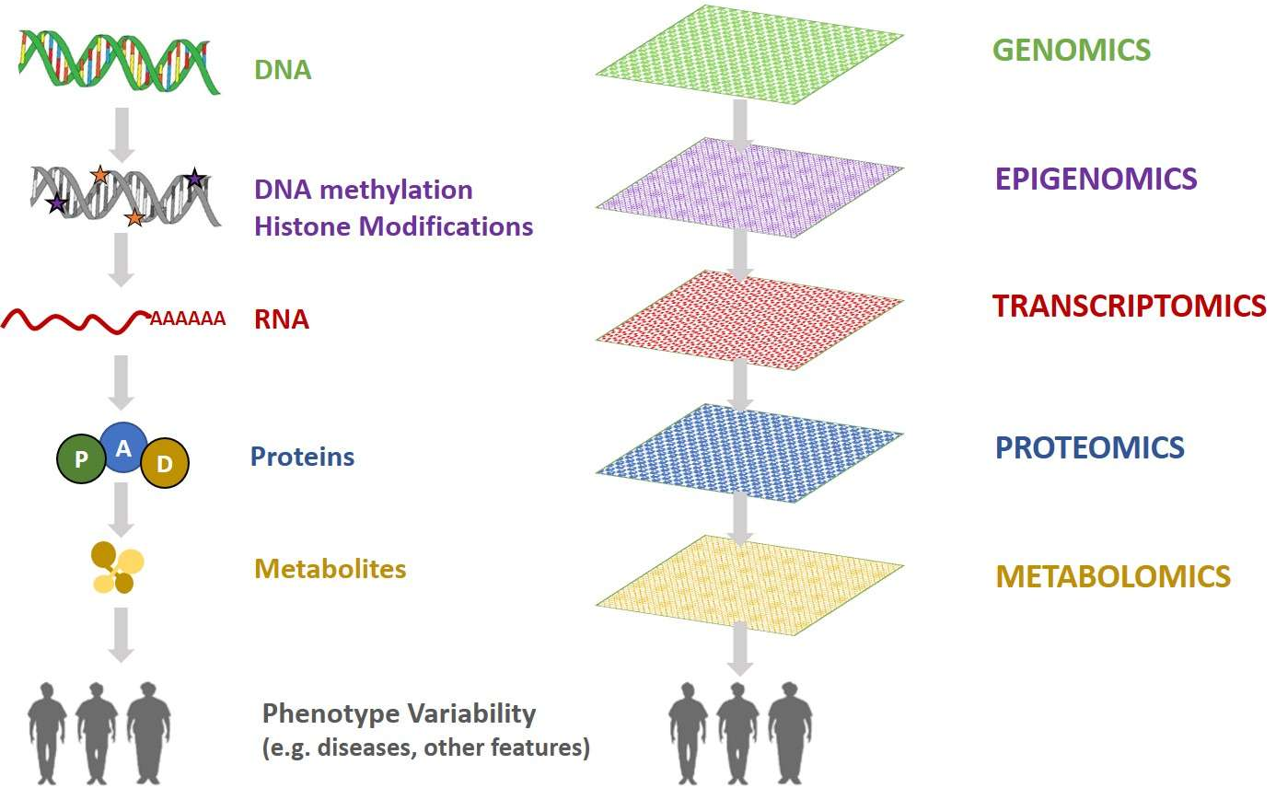
Omics data
Omics
High throughput
Measurement of all or as many as possible molecules of a given biomolecule (e.g., DNA, proteins, metabolites).
Measurements performed using high-throughput instruments
E.g., Sequencers, Mass spec
Generally, yield large, multi-dimensional datasets.
Computational biology
Source: https://comics.dcv.fct.unl.pt/resources/

Slide 8
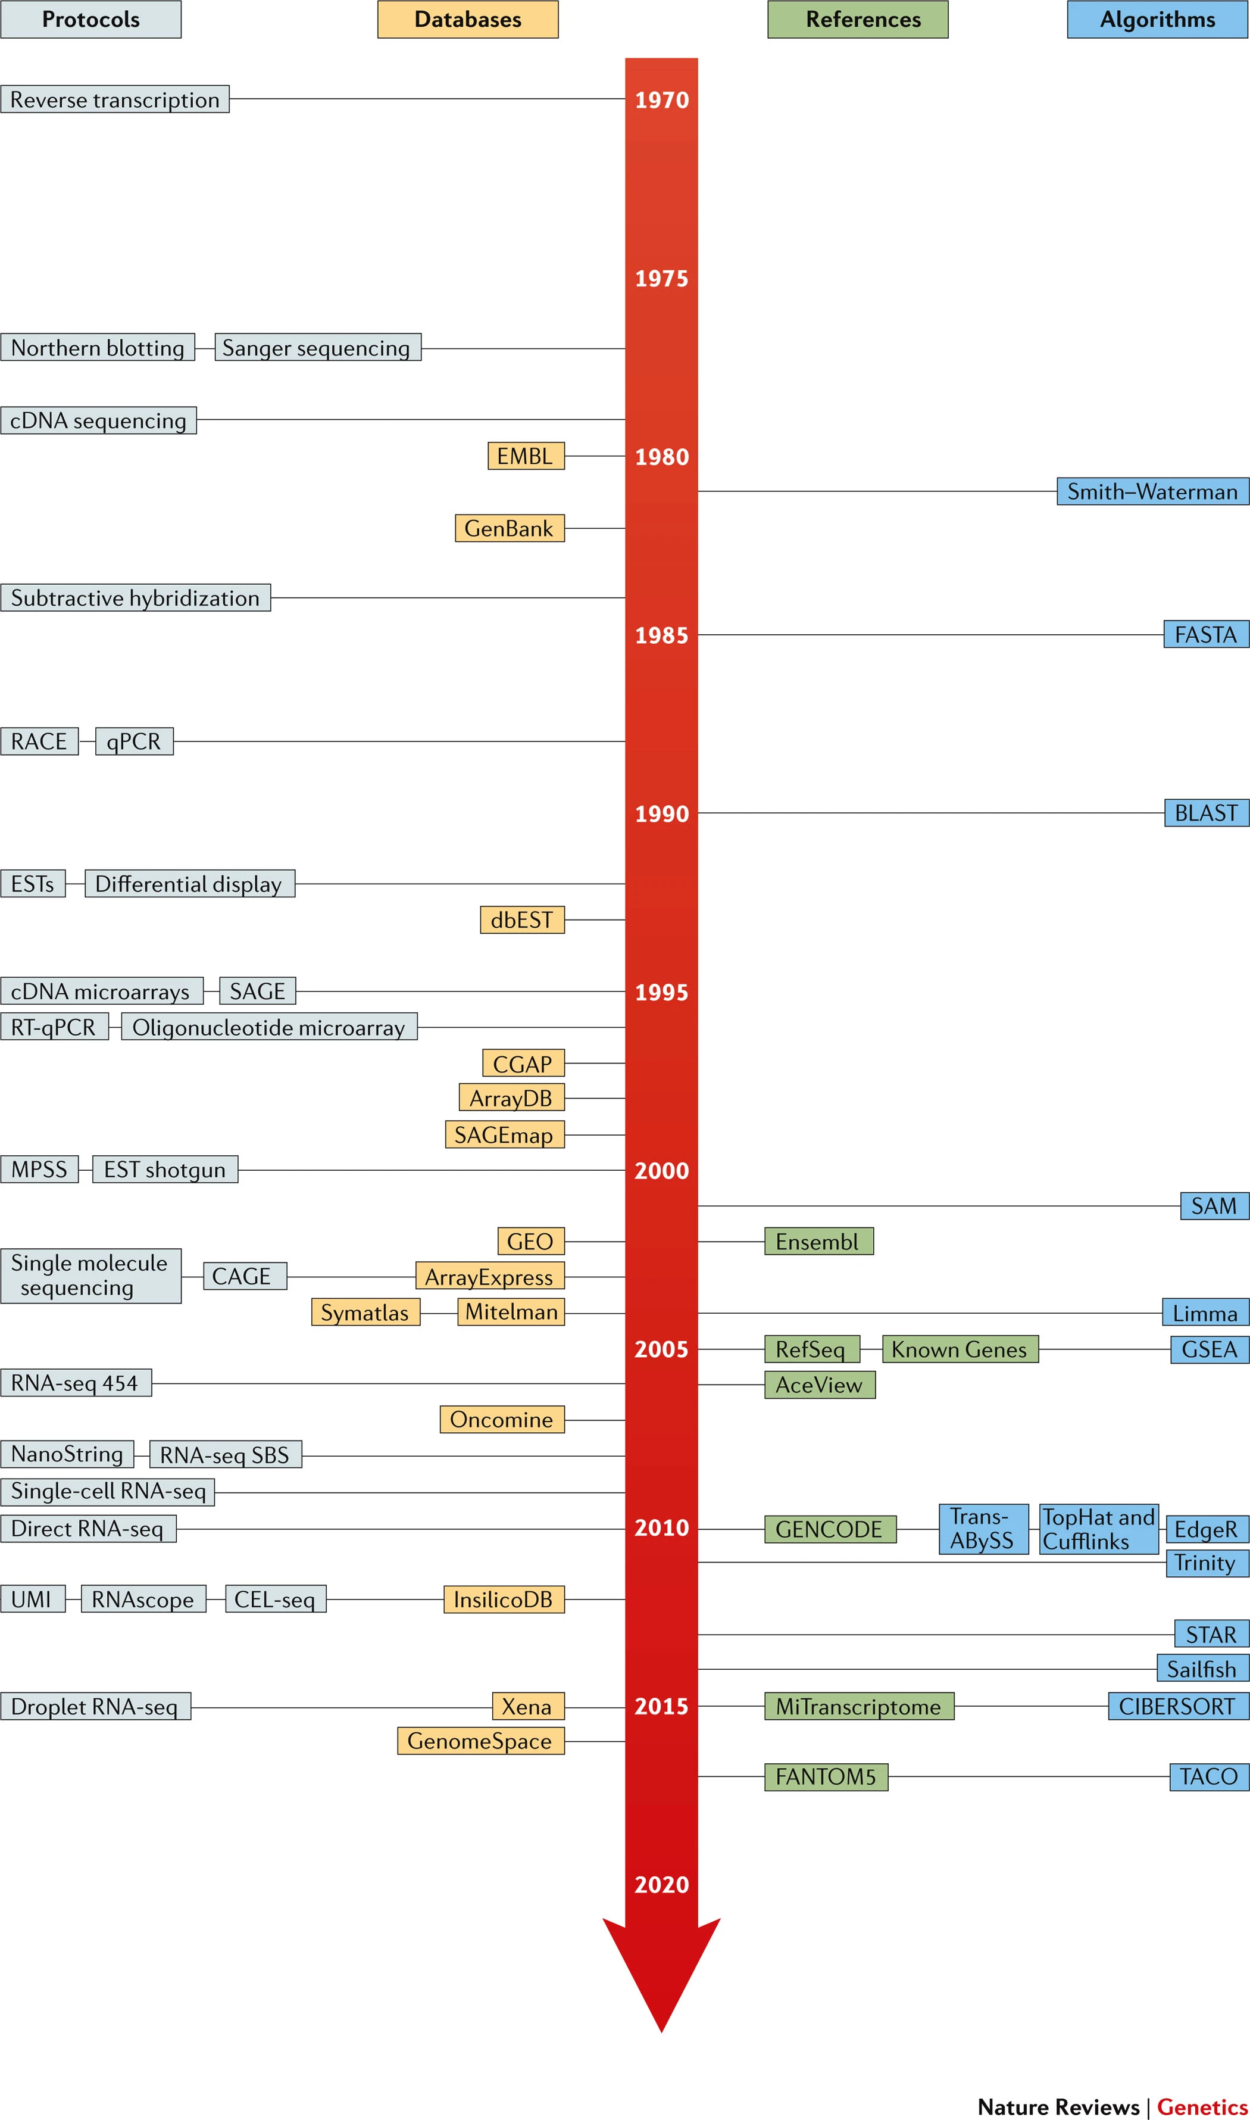
Transcriptomics
Relative quantification of mRNA levels (reverse transcribed into cDNA) in biological samples.
High-throughput sequencing (HTS), RNAseq currently main method but previously microarrays were used.
Single-cell RNAseq also now common, enabling measurement of transcriptome at single-cell level
Cieślik and Chinnaiyan 2017, Nature Reviews Genetics

Slide 9
Lecture Outline
1.
Introduction to Computational biology
2.
Introduction to the R programming language – theory and concepts
3.
Introduction to RNAseq
4.
Introduction to 16S rRNA sequencing

Slide 10


The R programming language
Free open-source language, first released in 1993.
Designed for statistical analysis and visualisation of data.
IDE Rstudio provides an easy interface to interact with R
Advantages | Disadvantages
Comprehensive ecosystem | Can be difficult to learn
Many, well-maintained and well documented libraries | Choosing between base R vs tidyverse can be difficult for beginners.
R is a high-level language, which can be run in real time and does not require compilation | Relatively slow in comparison to other languages

Slide 11
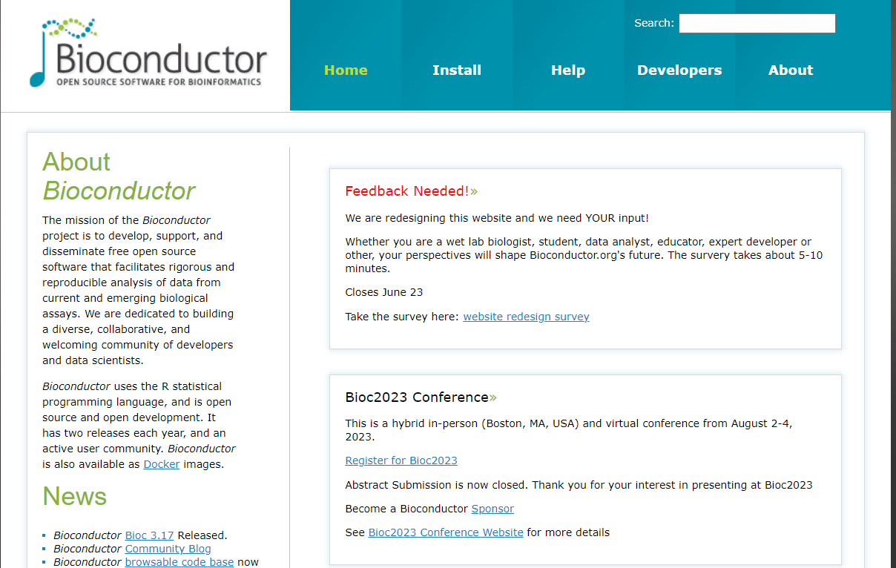
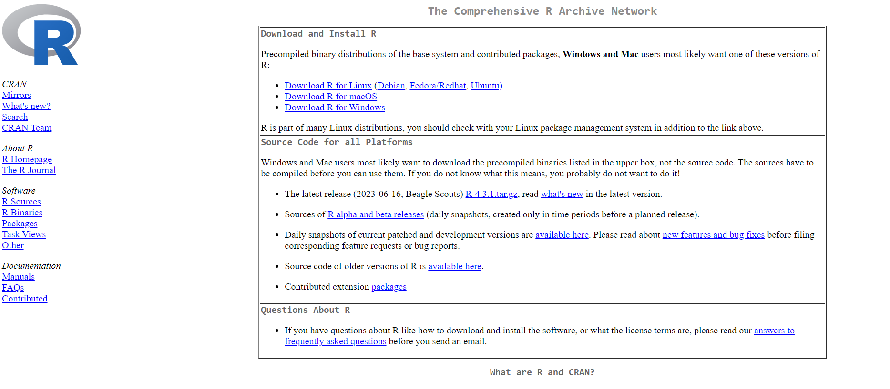
R for computational biology
R packages for computational biology, generally installed from two main sources: CRAN or BioConductor.
CRAN is mostly statistical/general purpose packages
BioConductor comprises packages specifically designed for analysis of biological data.
Enables access to methods/algorithms to facilitate analysis
Both repositories (but particularly BioConductor) include extensive documentation and tutorials
Code is written in R scripts or using code notebooks (Rmarkdown/Quarto).
Writing code in notebooks is great for reproducibility.

Slide 12
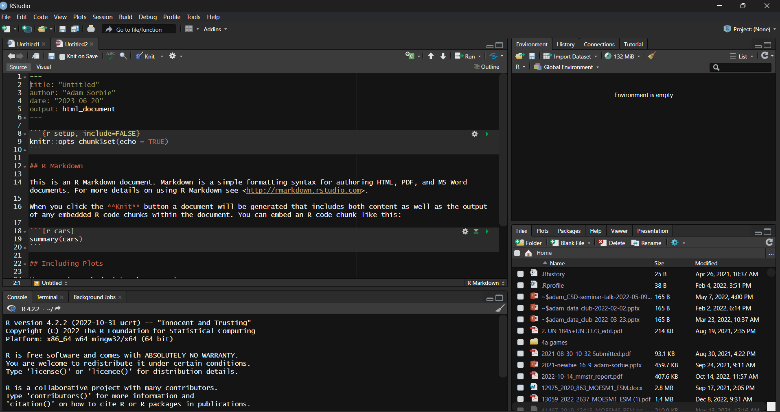
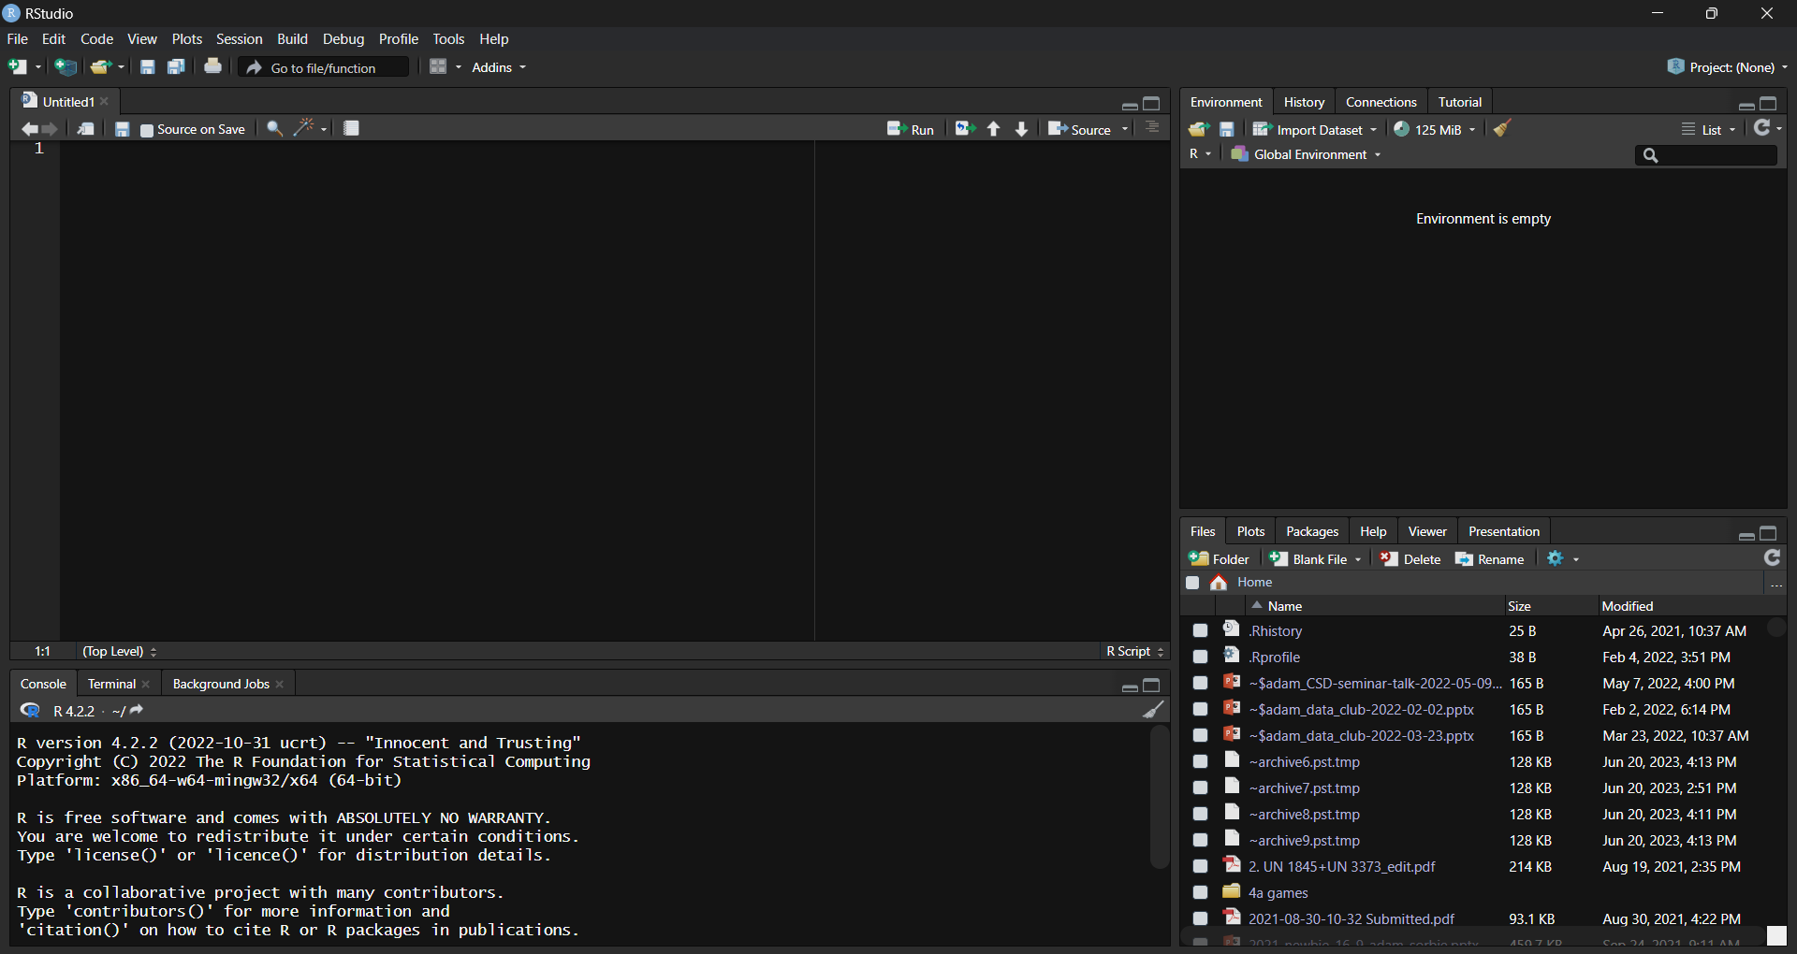
Working with R/Rstudio
Script editor – where you write scripts
Console – run code interactively
Environment – things you create/source stored here.
In an Rmarkdown notebook the script editor is replaced with a notebook allowing you to intersperse text with code blocks.
Script editor
Environment
Notebook
Script editor
File system/help/packages
Console

Slide 13
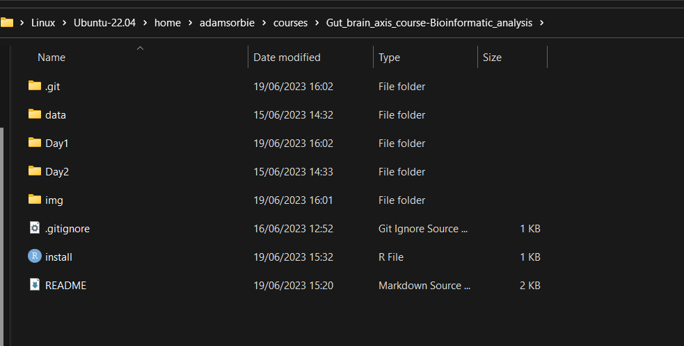
Working with R/Rstudio – working directory
Working directory is a crucial concept to understand
Where R is looking for/outputting files
Check current working directory with get_wd() or set with set_wd()
E.g. set_wd(“C:/Users/adam-/Gut_brain_axis_course-Bioinformatic_analysis”)
Important to understand the difference between relative and absolute paths.
Using above as example
Relative – “Day1”
Absolute – “C:/Users/adam-/Gut_brain_axis_course-Bioinformatic_analysis/Day1”

Slide 14
Working with R/Rstudio – writing and running code
You can write code in the console or script editor/notebook in case of Rmarkdown.
Always better to write a script/notebook as the code is recorded – reproducible.
To run a command press ctrl + Enter (cmd + Return on Macs)
In an Rmarkdown notebook, code can also be ran by pressing the green play button
Rmarkdown
Typing outside of a code block is interpreted as markdown text
To insert a new code block press ctrl + alt + I (again replace ctrl with cmd on Macs)

Slide 15
Lecture Outline
1.
Introduction to Computational biology
2.
Introduction to the R programming language – theory and concepts
3.
Introduction to RNAseq
4.
Introduction to 16S rRNA sequencing

Slide 16
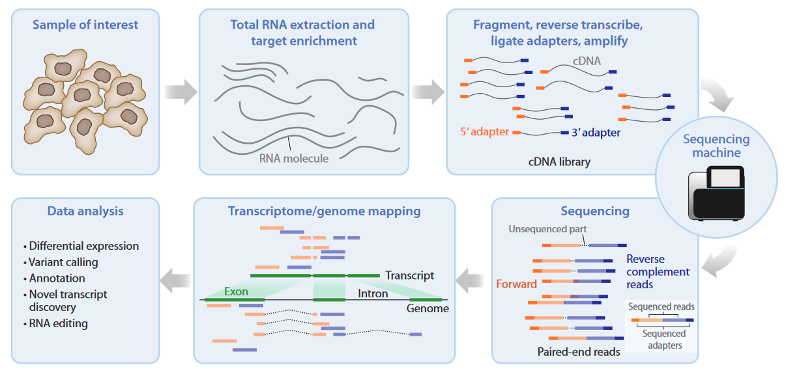
RNAseq - principle
Van den Berge et al, 2019. Annual Review of Biomedical Data Science

Slide 17
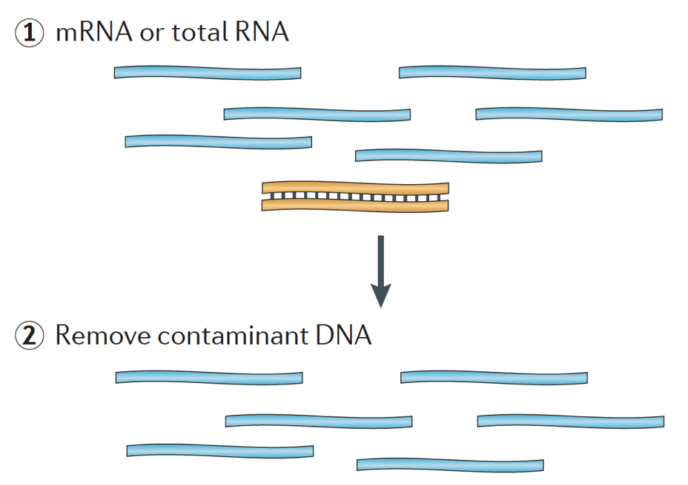
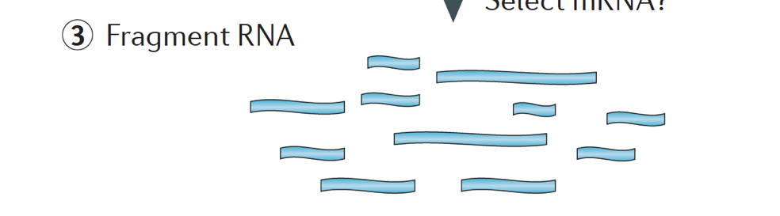
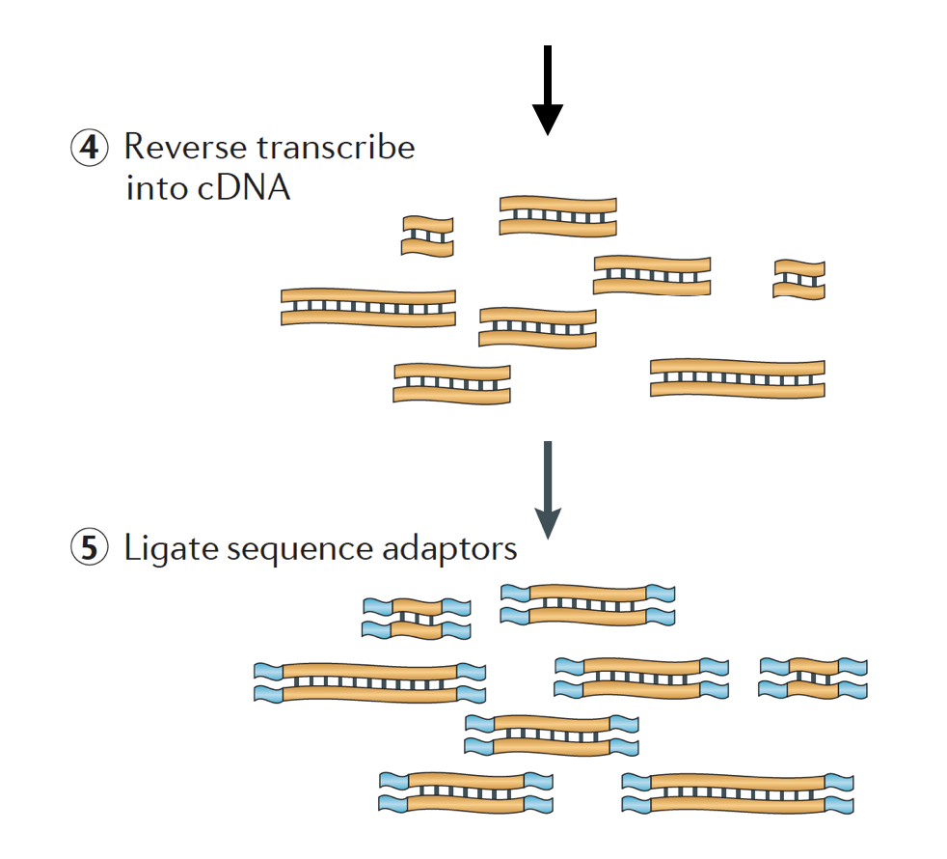
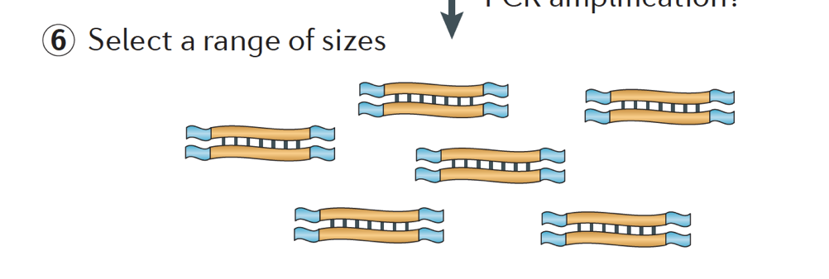
Library preparation
Remove rRNA
PCR amplification

Slide 18
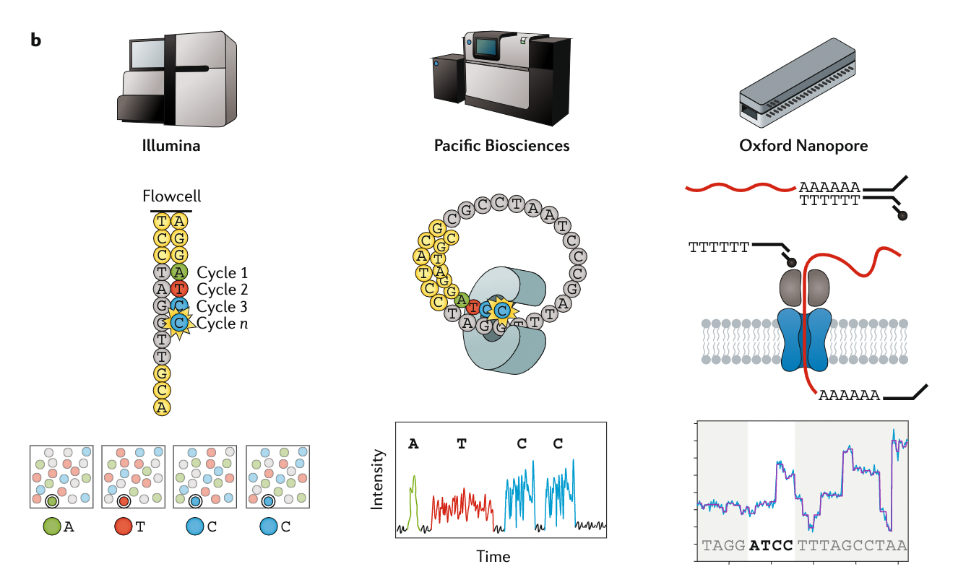
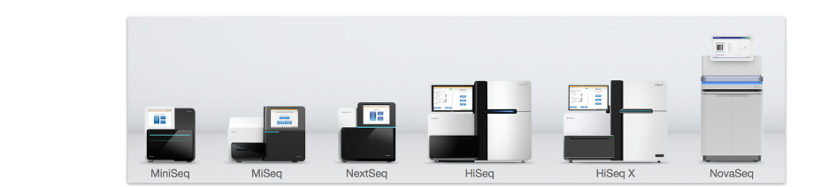
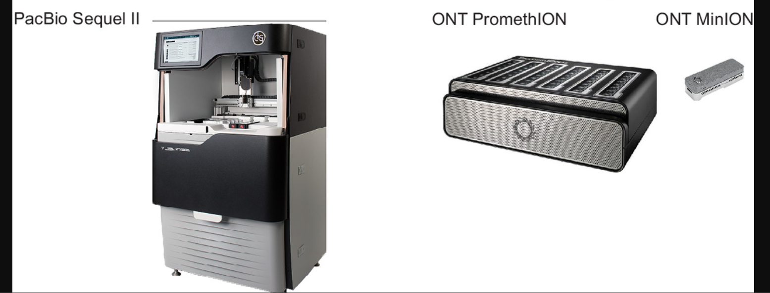
Sequencing platforms
Short read
Long read
Stark, Grzelak and Hadfield, 2019 Nature Reviews Genetics

Slide 19

Sequencing – Key concepts
Typical read length: 50-150bp.
Single-end (SE) vs. paired-end (PE)
SE: each (amplified) fragment is only sequenced once, from one direction.
PE: each (amplified) fragment is sequenced from both directions:
Sequencing depth
Total number of reads. Should be >20 million for standard gene-expression analysis without bells and whistles.
Phred (Q) score: each base assigned quality score
Probability (P) of base call being wrong. Q = -10 log10 P. E.g., Q = 10, P = 0.1 (poor); Q = 40, P = 0.0001 (good)

Slide 20
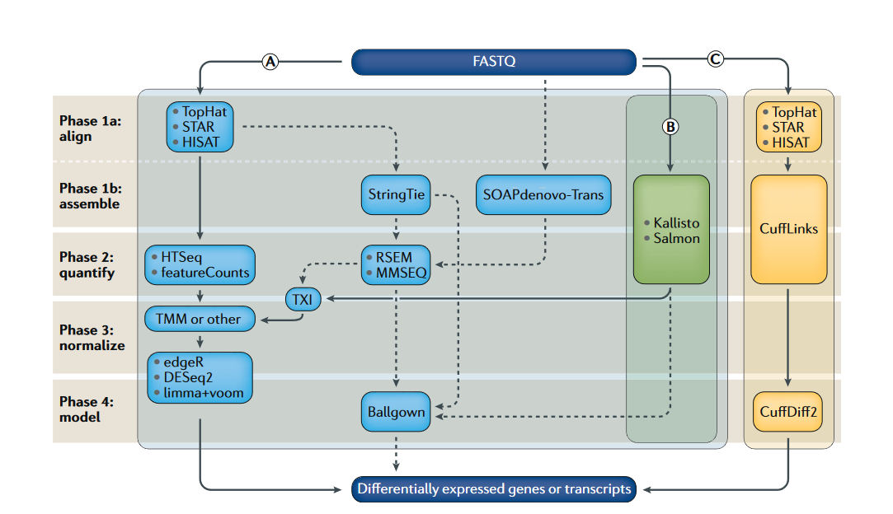
RNAseq data processing steps
QC
Stark, Grzelak and Hadfield, 2019 Nature Reviews Genetics

Slide 21
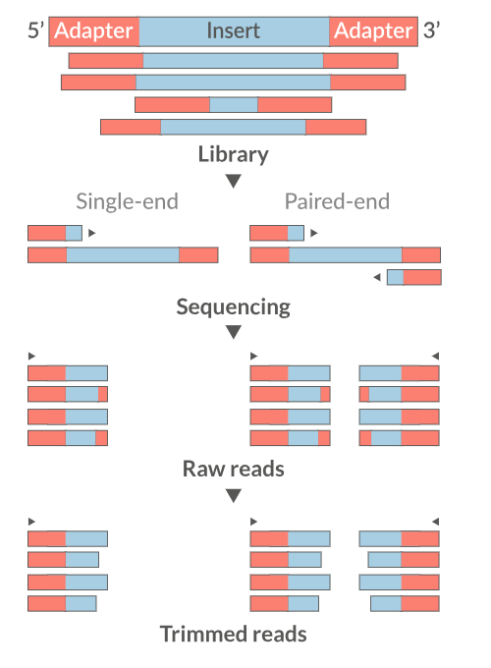
Quality control
Examine read quality
FastQC, MultiQC
Remove any adapter sequences , filter low quality reads
Trimmomatic, Cutadapt
Trimming and filtering poor quality bases/reads improves mapping rate

Slide 22
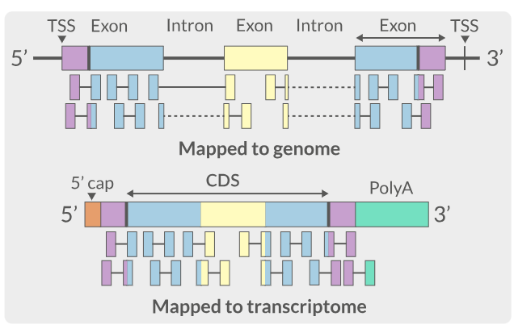
Mapping and quantification
Aligning trimmed and filtered reads to reference sequence
Genome (splice-aware) or transcriptome.
Quantifying number of hits to each gene/transcript
Genome
Transcriptome

Slide 23
RNAseq data analysis steps
Exploratory data analysis
Pathway/GO analysis
Stark, Grzelak and Hadfield, 2019 Nature Reviews Genetics

Slide 24
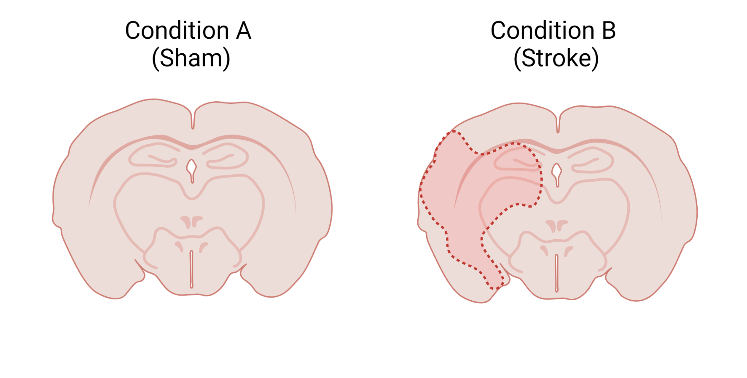
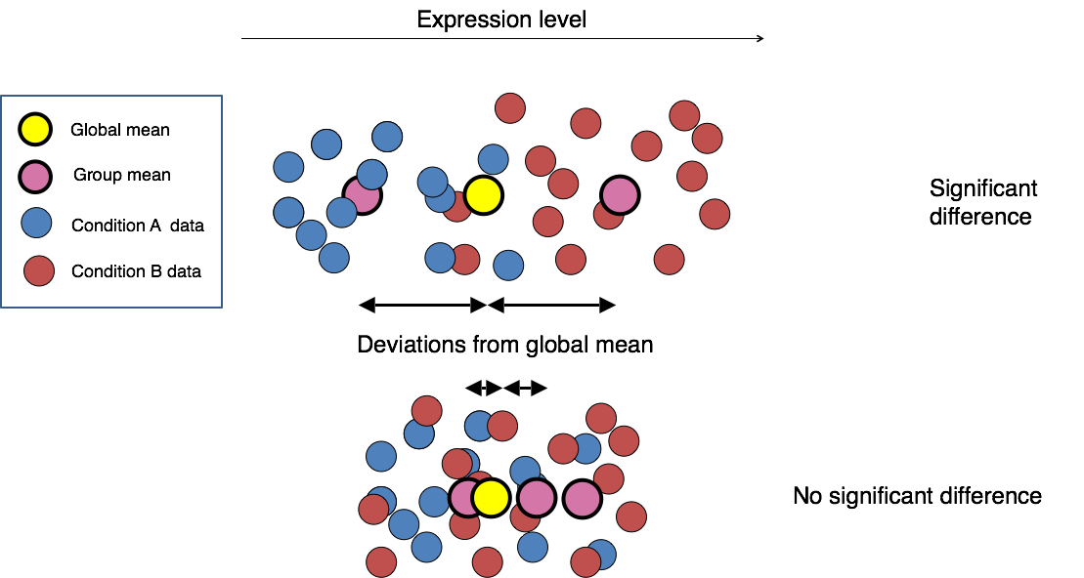
Differential expression
Which genes/transcripts are different between conditions?
Common tools include DESeq2, edgeR and limma/voom.

Slide 25
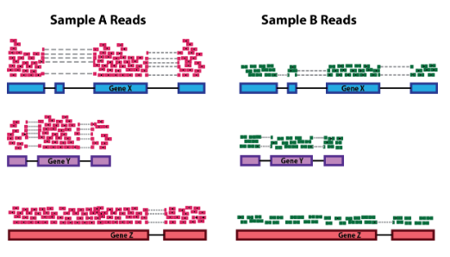
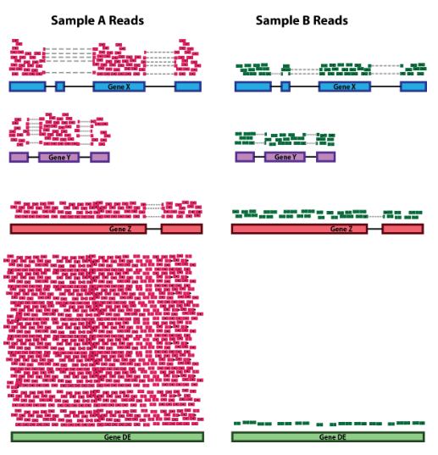
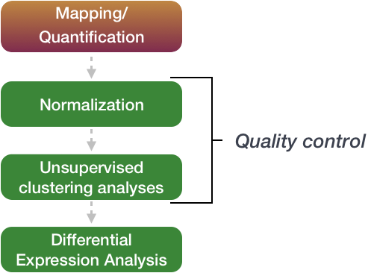
Differential expression - Normalization
Sequencing depth
Post-mapping –
Count matrix representing number of reads originating from each gene/transcript.
Raw counts not comparable between samples
Sequencing depth and RNA composition differ.
RNA composition

Slide 26
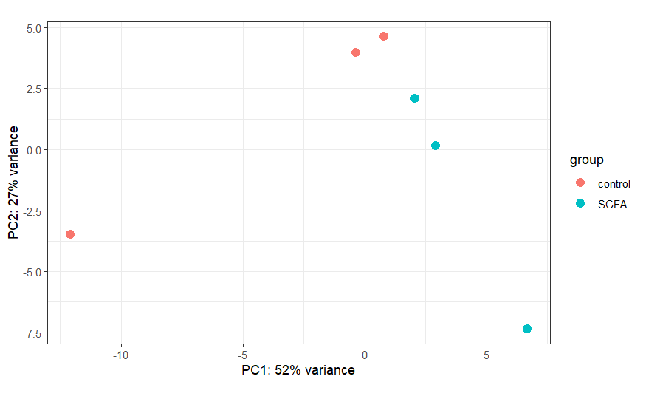
Differential expression - Unsupervised clustering
Important to understand how similar/different samples are.
Also useful to examine data for outliers/confounding variables
Principal component analysis (PCA) is a useful tool for this

Slide 27
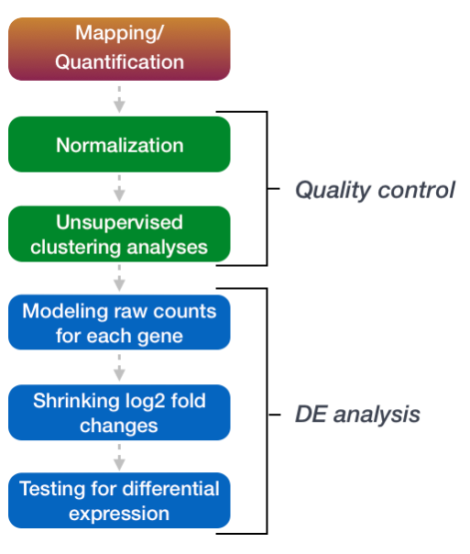
Differential expression – Identifying DEGs
Using DESeq2 as an example, identification of DEGs can be split into 3 steps:
Apply statistical model (in this case a negative binomial model) to the raw counts for each gene.
Estimate Log2FC and shrink imprecise estimates
Identify differentially expressed genes using hypothesis testing (in this case a Wald test, with the null hypothesis that there is no difference in expression between groups.

Slide 28
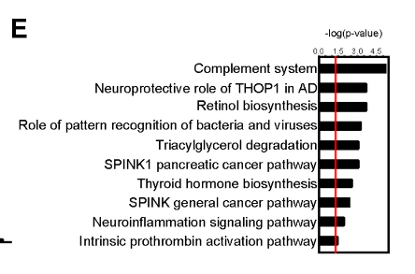
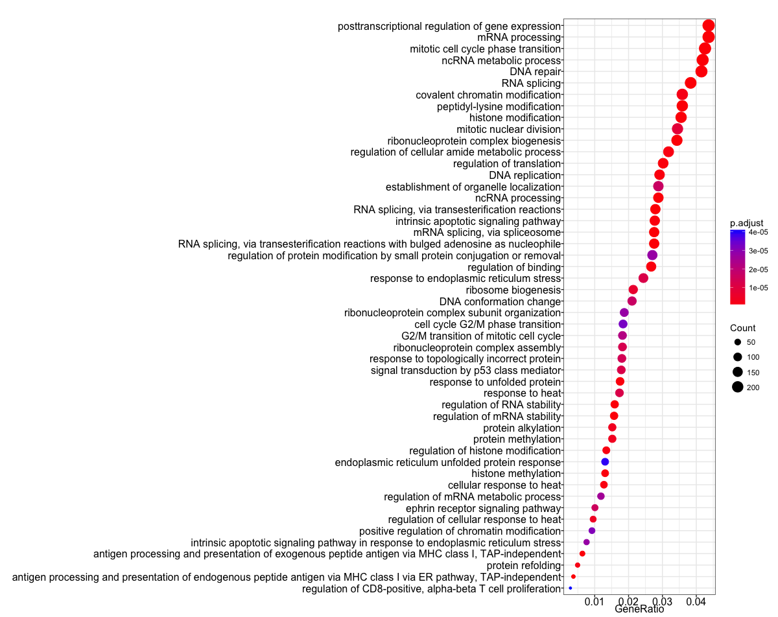
Gene ontology/Enrichment analysis
After identifying DEGs assigning pathways or functions to groups of genes can help make sense of results
Three main types: Over-representation analysis, functional-class scoring and pathway topology.
Common tools include R-based tools such as clusterProfiler and enrichR or online tools, like GSEA or DAVID.
Sadler et al, 2020, Journal of Neuroscience
Source: https://hbctraining.github.io/Training-modules/DGE-functional-analysis/lessons/02_functional_analysis.html

Slide 29
Lecture Outline
1.
Introduction to Computational biology
2.
Introduction to the R programming language – theory and concepts
3.
Introduction to RNAseq
4.
Introduction to 16S rRNA sequencing

Slide 30
Sample processing and collection steps
Experimental design/power analysis
Sample type, collection method & storage
DNA extraction
Library preparation & Sequencing/Sequencing method

Slide 31
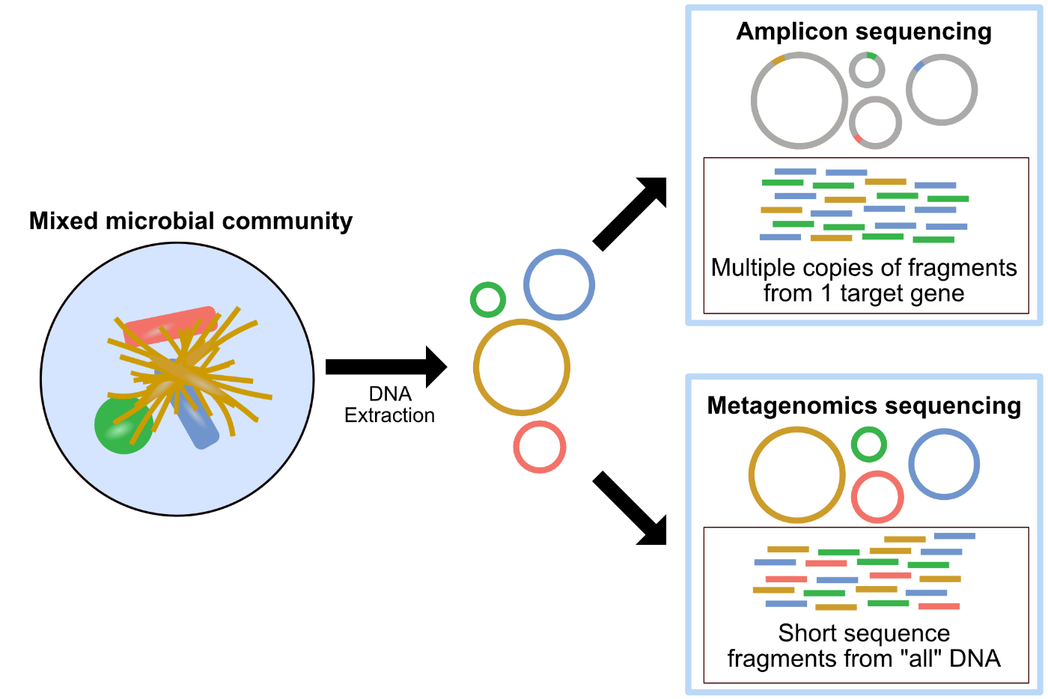
Profiling method - 16S vs Shotgun metagenomics
16S rRNA sequencing
Targeted PCR amplification and sequencing of the 16S ribosomal RNA gene
Useful for discerning community level changes in structure or composition and generating hypotheses.
Not useful for determining abundance of organisms in sample or looking at function.
Shotgun metagenomics
Amplification and sequencing of all DNA in a sample.
Useful for species/strain level identification, functional potential, better at measuring abundances (relative).
Not useful for: true abundance, active function i.e. What genes are being actively transcribed

Slide 32
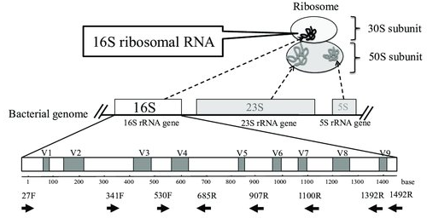
16S rRNA Sequencing - Principal
Small ribosomal subunit
Composed of conserved and hypervariables (V) regions
Can be exploited be identify bacteria (and in some cases archaea)
Relatively inexpensive
Short amplicon sequences ~150-500bp matched against database of full-length sequences to identify bacteria
Usually limited to family/genus level classification

Slide 33
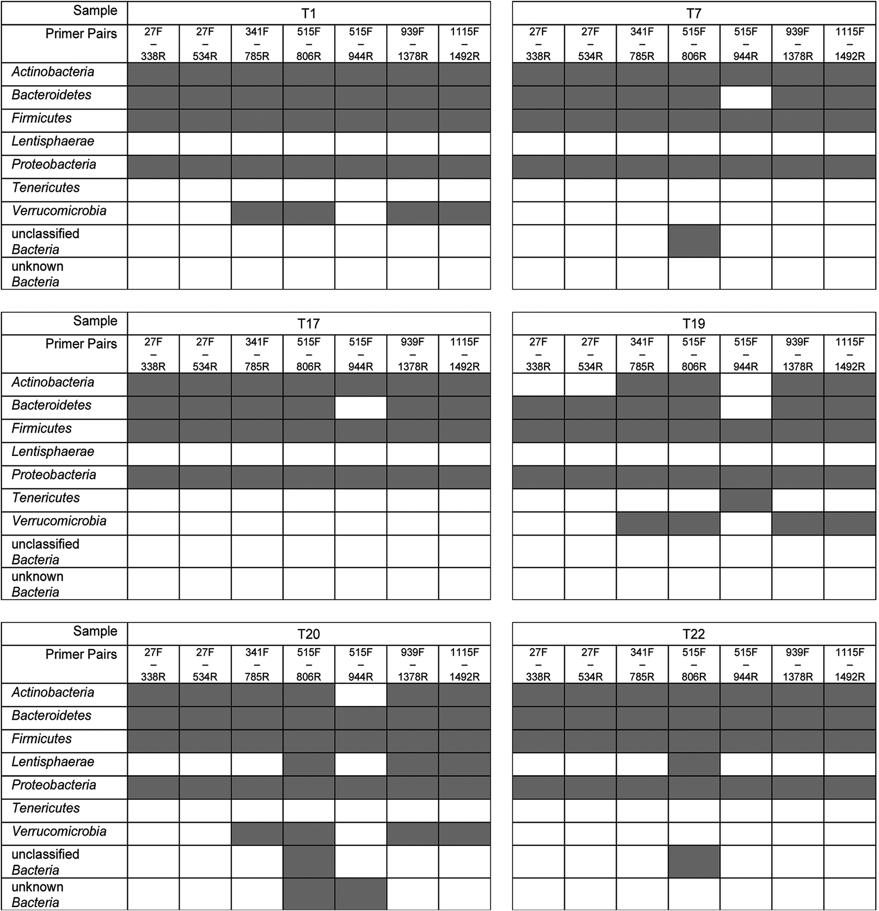
Library preparation and sequencing
Primer/V region choice has a massive impact on resulting microbial community
Number of cycles used during PCR also impact composition/presence of artifacts
HiSeq and MiSeq most commonly used for 16S studies, HiSeq/Nextseq commly used in metagenomics
Abellan-Schneyder et al 2021, mSphere

Slide 34
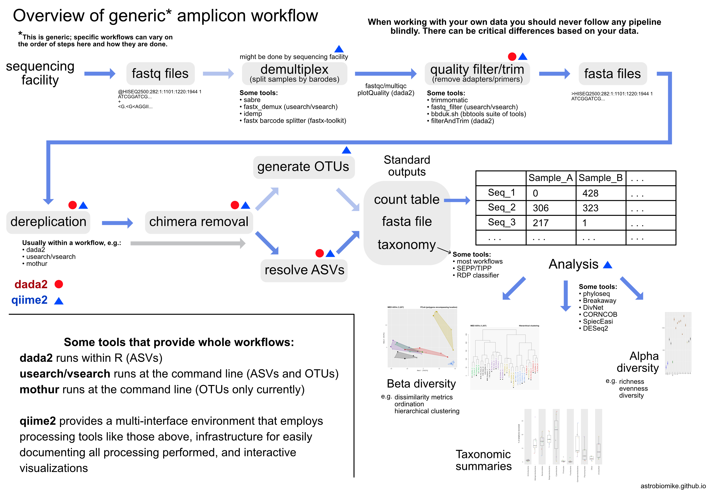
Data processing steps
Like RNAseq raw data is delivered as FASTQ files.
QC
Denoising
Taxonomic assignment/Phylogenetic tree generation
Source: https://astrobiomike.github.io/amplicon/
Notes:
Many software suites/pipelines to choose from
Qiime2, DADA2, USEARCH, mothur
Choice of software depends on user preference
Widely-used, well-maintained, extensive documentation – good criteria for choosing a particular tool

Slide 35
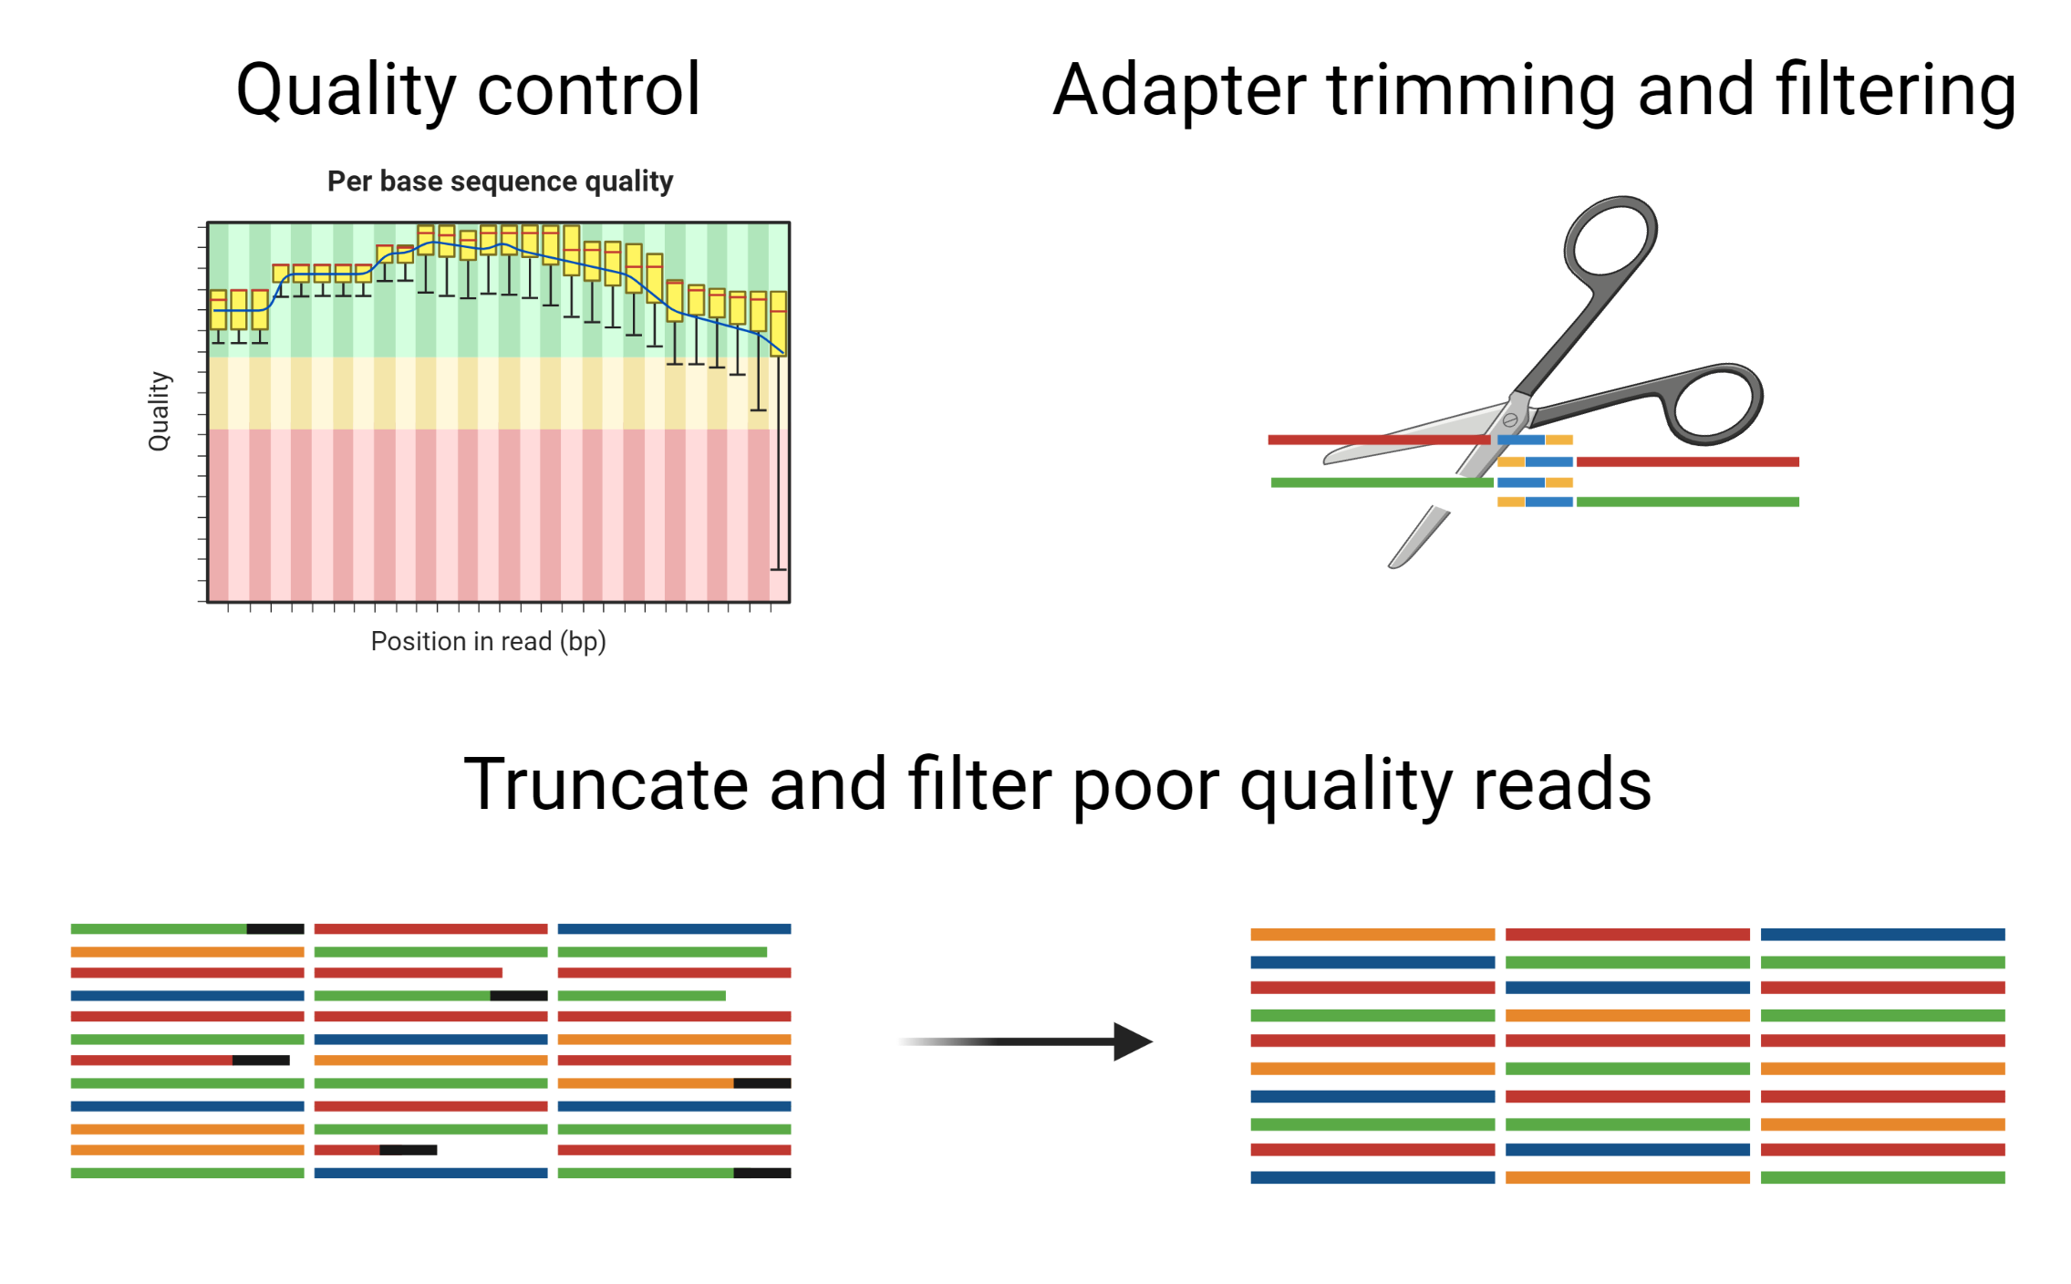
QC
Adapter/primer trimming
Truncate and filter low quality reads
Non-biological sequences/low quality bases interfere with taxonomic assignment.

Slide 36
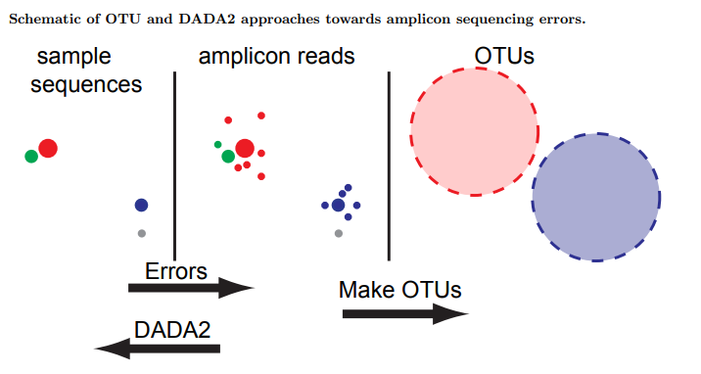
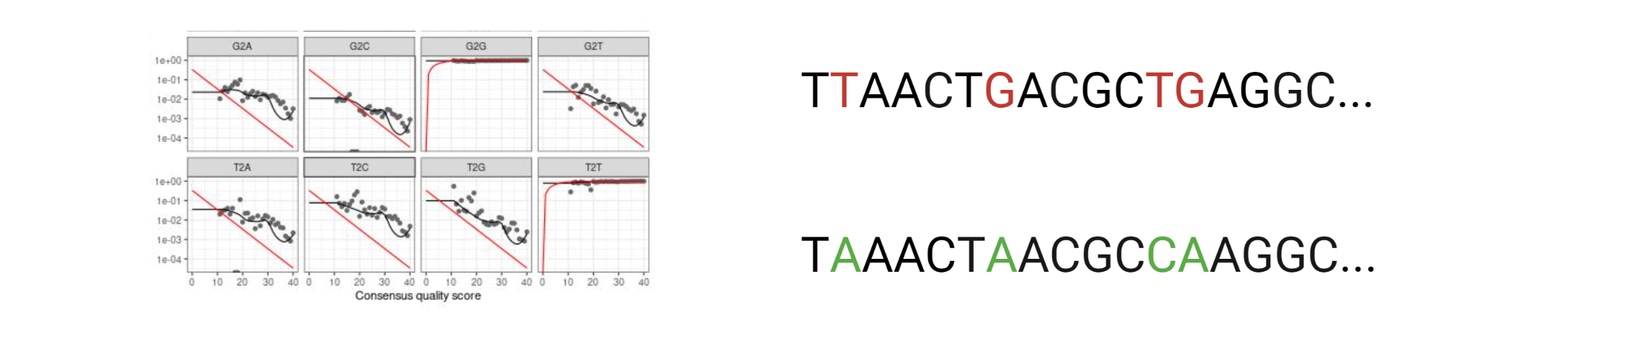
Denoising reads
Improves upon previous method of OTU clustering.
Sequences binned at 97% sequence identity.
Broadly speaking, most methods generate statistical models of error profiles, to identify and remove errors.
Generates real biological sequences, at single nucleotide resolution.

Slide 37
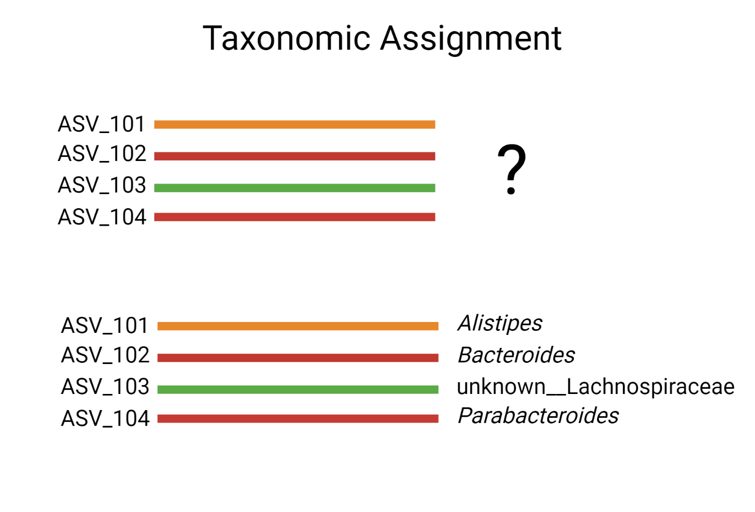
Taxonomic classification
Post-denoising, ASVs assigned taxonomic classification to identify source of sequence
Widely used methods use ML models trained on curated full-length sequence database to classify unknowns.
Databases – SILVA, RDP, Greengenes2
Methods – DECIPHER, RDP-classifier, qiime2 feature-classifier
Resolution depends on length and database used
Assignments differ between databases
Some environments better represented than others

Slide 38
Outline
1.
Microbiome sample preparation
2.
Microbiome data processing
3.
Microbiome data analysis

Slide 39
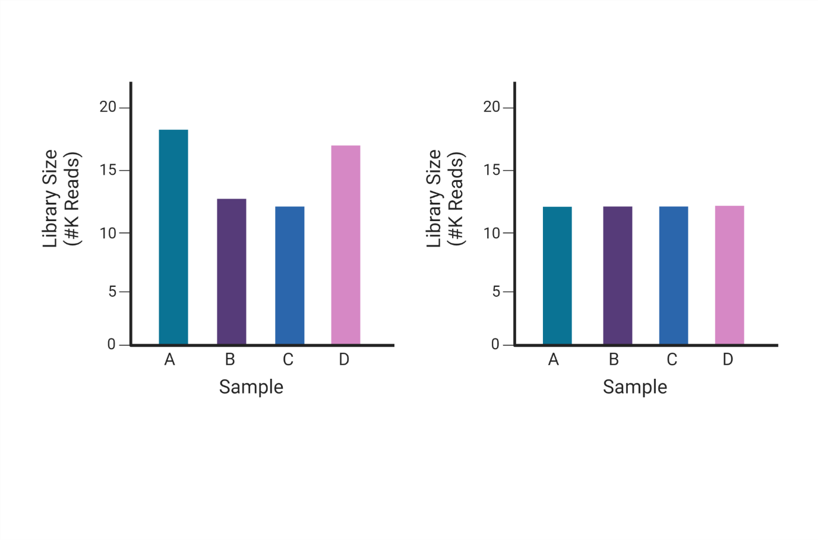
Normalisation – data transformations
Biological and technical variation lead to different library sizes between samples.
Must be controlled for to limit erroneous conclusions
Most commonly used methods are rarefaction or relative abundance.
Rarefaction discards data and not always recommended.
Other methods include minimum sum scaling (MSS).
Scaling of counts to a common factor e.g. lowest sum
Many publications (though not all) now maintain that microbiome data is compositional
Relative information, summing to a constant e.g., 1 or 100
This has implications for how we normalise and analyse our data.
Log-ratio transforms (commonly CLR) used for normalisation
Before normalisation
After normalisation

Slide 40
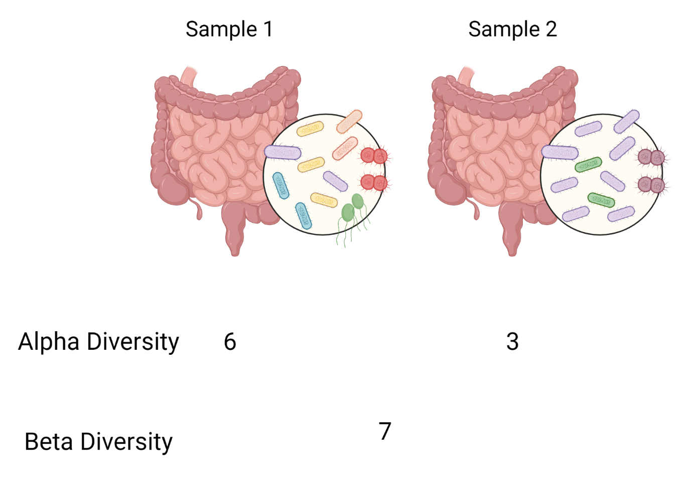
Diversity metrics
Community level
Alpha diversity – within sample, how many different species are present?
Beta-diversity – between samples, how does the composition of species differ among samples?

Slide 41
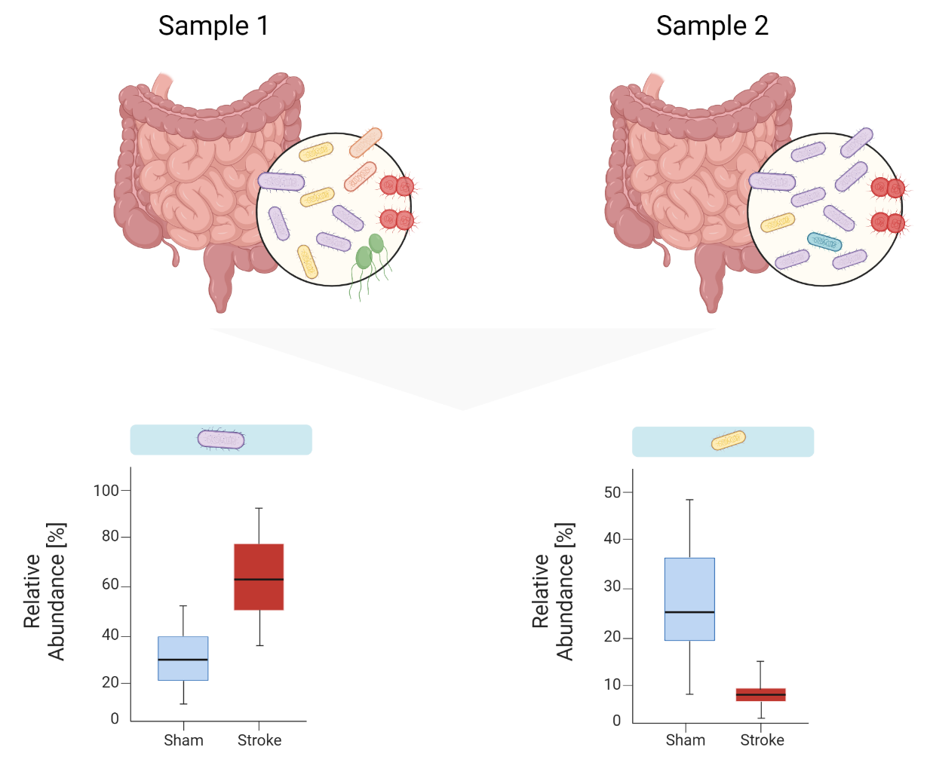
Differential Abundance
Which individual species differ between samples?
In this example, the purple species is enriched in stroke and yellow species is depleted.

Slide 42
Any questions?

